Slide 1
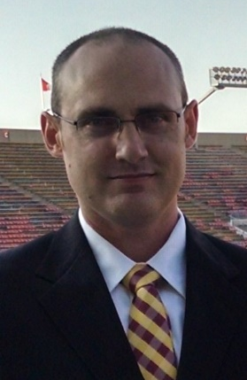
Image Recognition w/ Raspberry Pi
Evan Hennis
Google Developer Expert in Machine Learning
@TheNurl
https://eckronsoftware.wordpress.com
https://github.com/ehennis
YouTube: Evan Hennis
AI and IoT Bulgaria Summit, 2021

Slide 2



Speaker Bio
BS from Iowa State 2004
MS from Georgia Tech 2018
C# developer since 2004
GDE in Machine Learning 2019

Slide 3
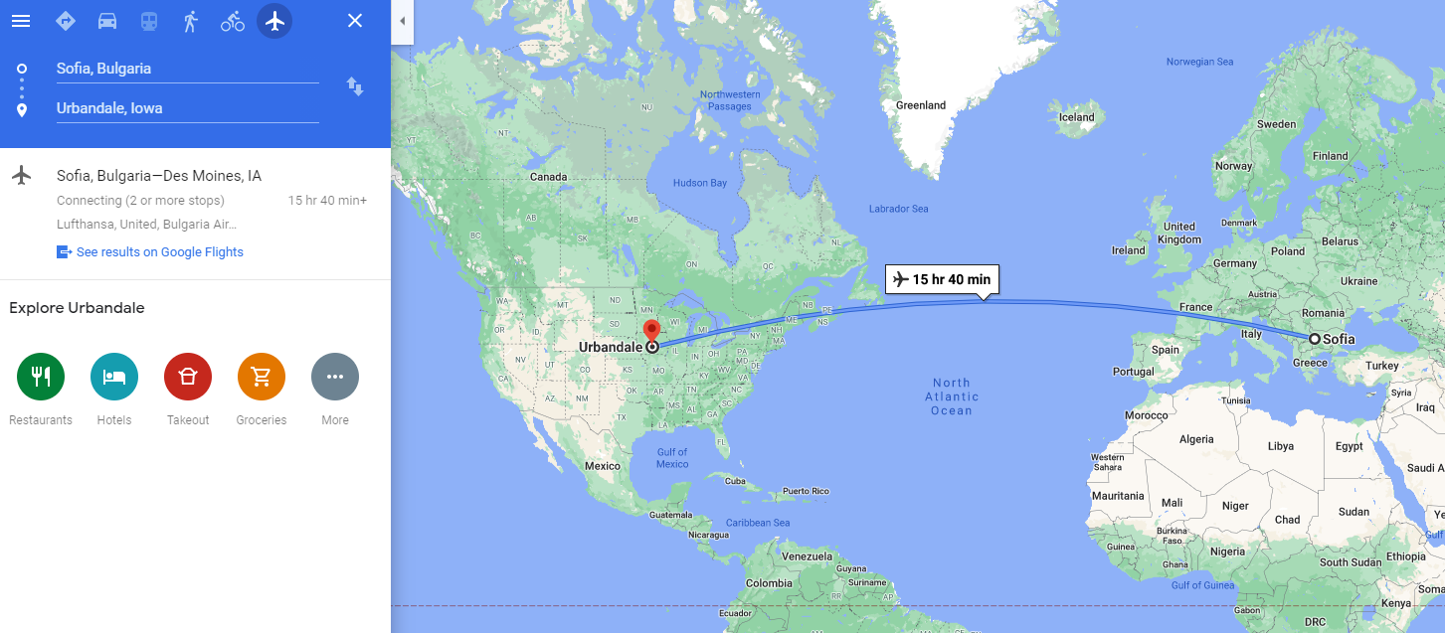
Where?

Slide 4
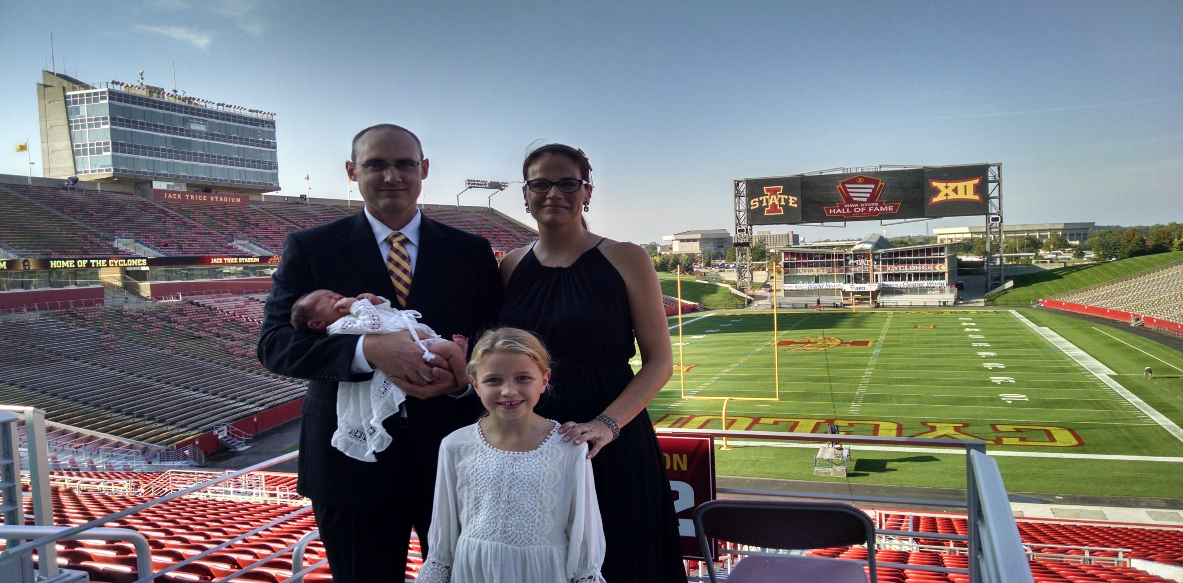

Slide 5
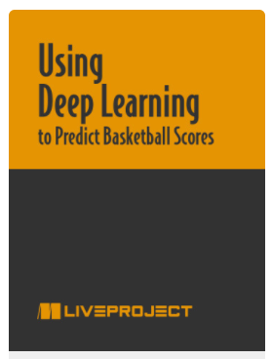
Using Deep Learning to Predict Basketball Scores
https://www.manning.com/liveproject/using-deep-learning-to-predict-basketball-scores
Discount Code: ctwiotaibg21

Slide 6
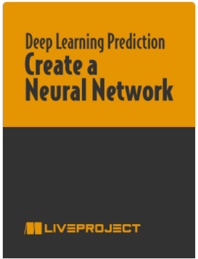
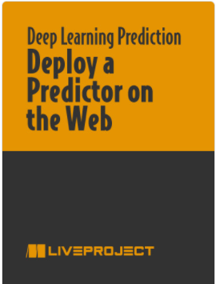
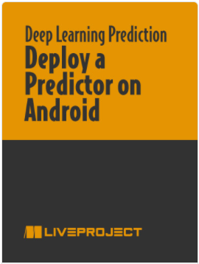
Deep Learning Project Series
https://www.manning.com/bundles/deep-learning-for-basketball-scores-prediction-ser
Discount Code: ctwiotaibg21

Slide 7





Thanks to our Sponsors

Slide 8
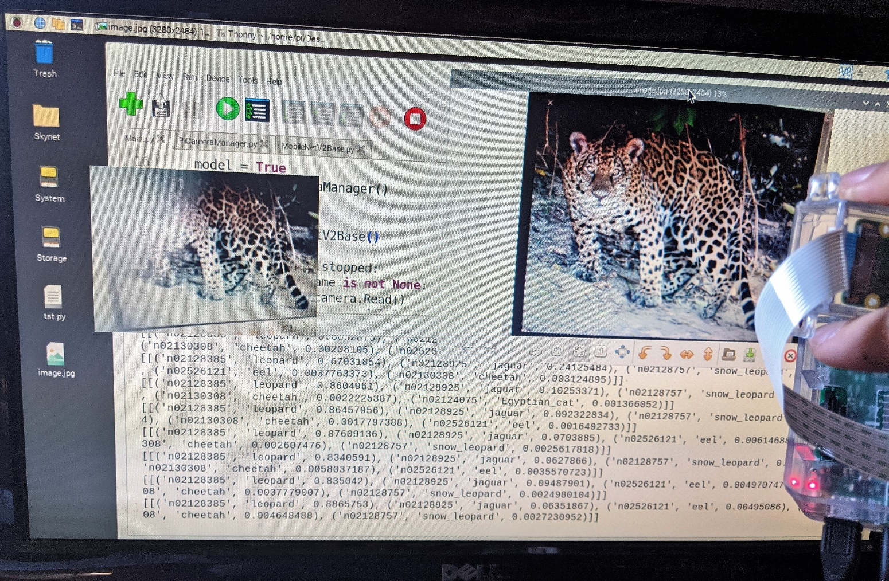
Agenda
Project Introduction
Raspberry Pi Setup (SD and OS)
Camera and API
TensorFlow v2 on ARM
MobileNetV2
Code and Demo
TensorFlow Lite Update
Future Projects
Conclusion

Slide 9
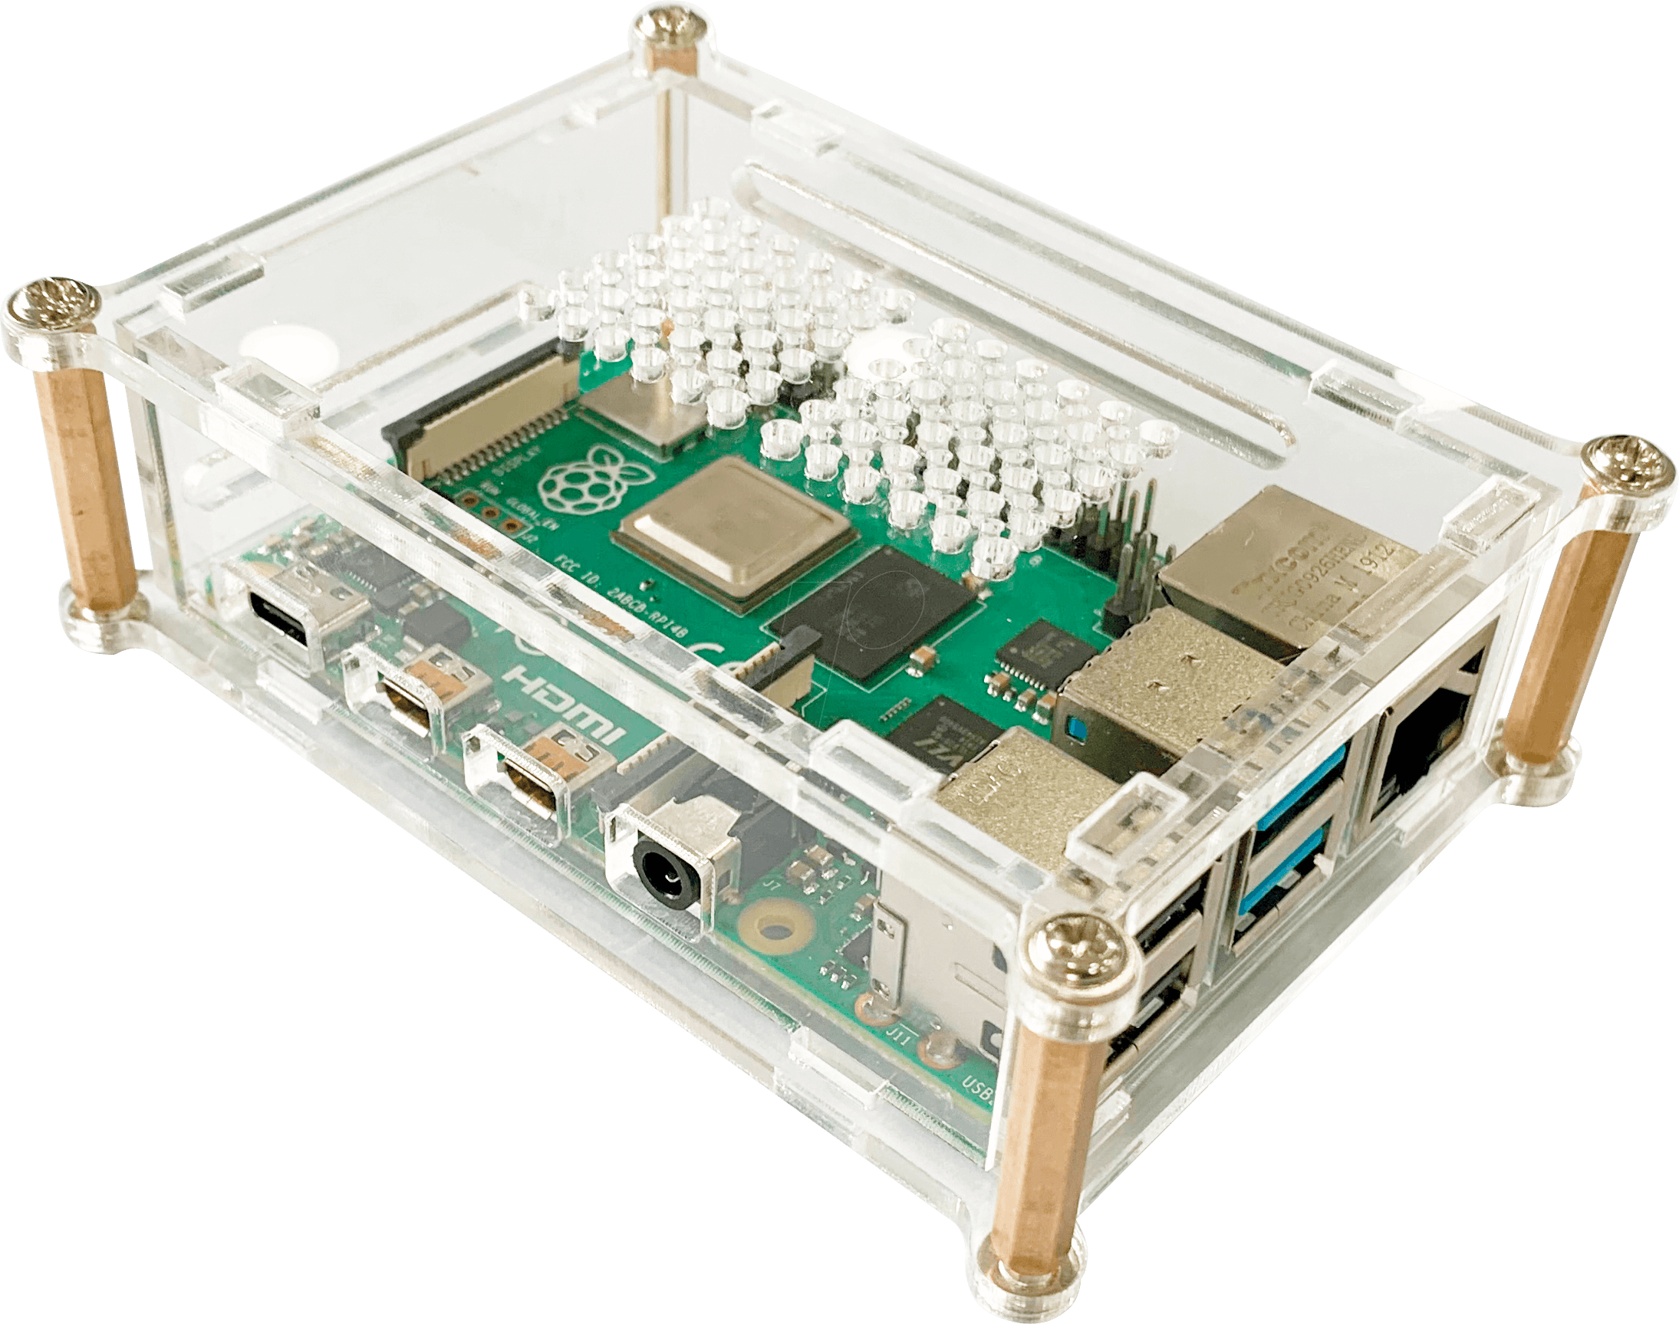
Project Introduction
Raspberry Pi 3
Raspbian (Now Raspberry Pi OS)
Raspberry Pi Camera Module V2-8 Megapixel
Leigh Johnson (@grepLeigh)

Slide 10
Raspberry Pi Setup (SD, OS, Camera)
SD Card
>= 8GB
Raspberry Pi Imager (Windows)
Don’t:
>32GB
Write protect your card
Raspberry Pi OS (Formerly Raspbian) or Noobs

Slide 11
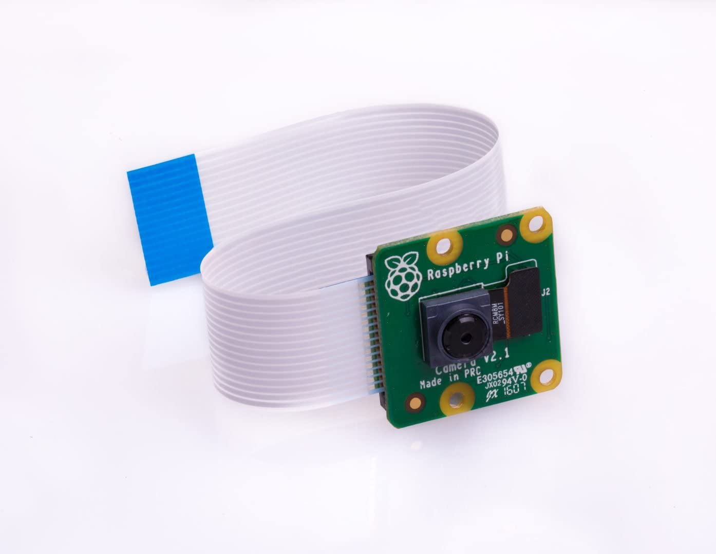
Camera and API
Camera: V2 8 Megapixel
API: PiCamera
Sudo apt install python3-picamera

Slide 12
TensorFlow v2 on ARM
TensorFlow v2 doesn’t support ARM
TensorFlow Lite is preferred going forward
I will demonstrate this later in the presentation. Also works with Android.
TensorFlow 2 ARM WHL: https://github.com/lhelontra/tensorflow-on-arm/releases

Slide 13
MobileNetV2
Built into Keras
tensorflow.keras.application.mobilenet_v2
Version 3 is out

Slide 14
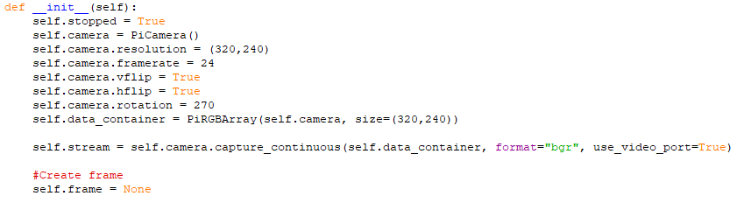
Camera Code (Initialization)

Slide 15
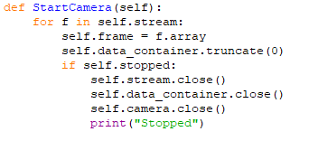
Camera Code (Stream)

Slide 16
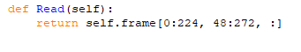
Camera Code (Read)

Slide 17
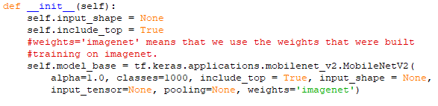
MobileNet (Initialize)

Slide 18
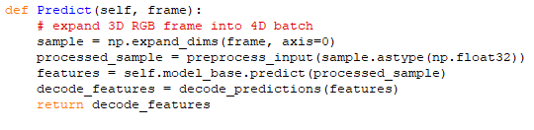
MobileNet (Predict)

Slide 19
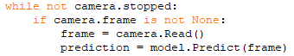
Main

Slide 20
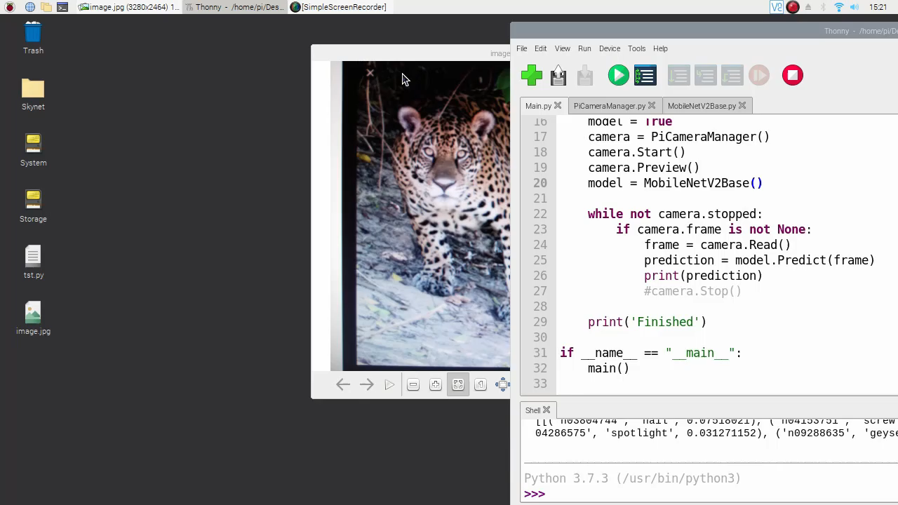
Demo

Slide 21
TensorFlow Lite
Convert Keras model to TF Lite Model
Link: https://github.com/ehennis/Blog/blob/master/ImageDetection/ConvertToLite.ipynb
Install TensorFlow Lite subset
Create TF Lite Interpreter

Slide 22
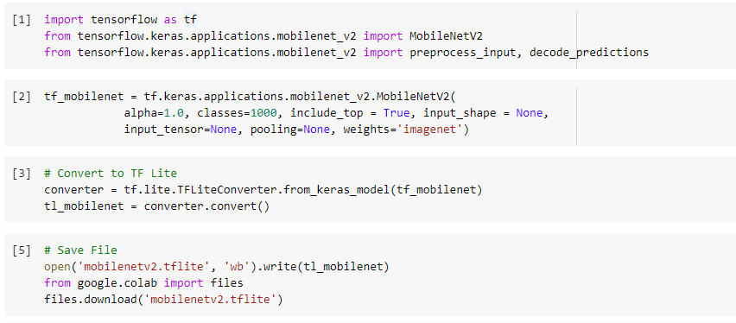
TensorFlow Lite (Model Conversion)

Slide 23
TensorFlow Lite (Install)
Follow Guide: https://www.tensorflow.org/lite/guide/python
For the Raspberry Pi
pip3 install https://dl.google.com/coral/python/tflite_runtime-2.1.0.post1-cp37-cp37m-linux_armv7l.whl

Slide 24
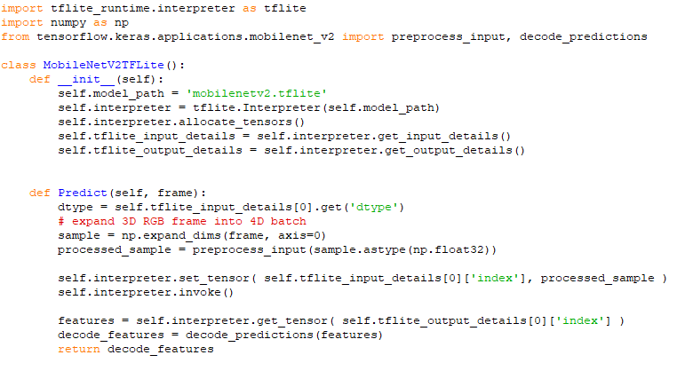
TensorFlow Lite (TF Lite Interpreter)

Slide 25
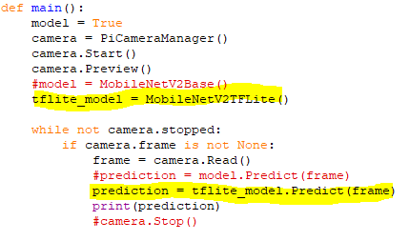
TensorFlow Lite (TF Lite Main)

Slide 26
Future Projects
Use transfer learning and train on a subset of images
Family pictures, cars, etc.
Implement object tracking for security cameras
Add to an automated home to turn the lights on when you show up
Really dumb but someone online added a Pi to his clock so that if anyone was looking at the clock it would jump off the wall
Anything…

Slide 27
Takeaways
Simple (Pretrained model, easy installs, and quick results)
Cheap ($35 Pi, $30 camera, $ SD card)
Easy (I was able to do it)

Slide 28
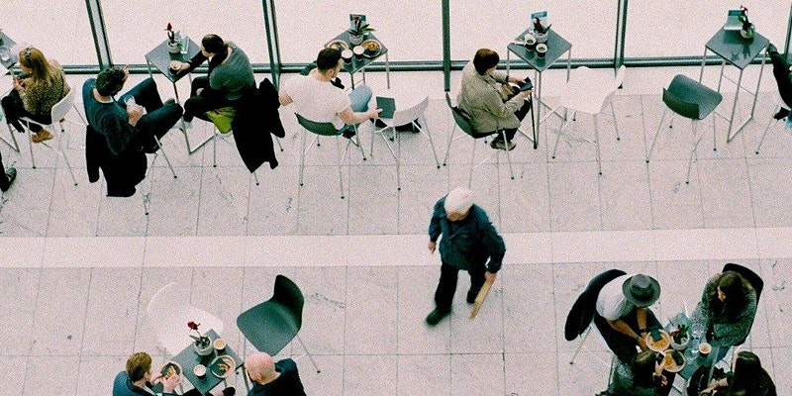

Upcoming Events
Data Saturday Plovdiv, 2021
August 28
Eventbrite
Data Saturday Sofia, 2021
October 09
Eventbrite
jsTalks (Bulgaria), 2021
Nov 19-20
http://jstalks.net/

Slide 29
Thanks to our Sponsors

Slide 30
Links
Leigh Johnson’s Project: https://towardsdatascience.com/portable-computer-vision-tensorflow-2-0-on-a-raspberry-pi-part-1-of-2-84e318798ce9
Camera Api: https://picamera.readthedocs.io/en/release-1.13/
TensorFlow 2 ARM WHL: https://github.com/lhelontra/tensorflow-on-arm/releases
MobileNetV2 Paper: https://arxiv.org/abs/1801.04381
MobileNet Classes: https://gist.github.com/yrevar/942d3a0ac09ec9e5eb3a
Code Repository: https://github.com/ehennis/Blog/tree/master/ImageDetection

Slide 31
My Information
Twitter: @TheNurl
GitHub: https://github.com/ehennis
YouTube: Evan Hennis
Blog: http://blog.eckronsoftware.com
Email: EvanHennis@gmail.com
Manning liveProject: https://www.manning.com/liveproject/using-deep-learning-to-predict-basketball-scores
Manning liveProject Series: https://www.manning.com/bundles/deep-learning-for-basketball-scores-prediction-ser

